Slide 1


Unit 6 – ARIMA
Scott Frazier

Slide 2
Day 1 Time Series – Which model is appropriate?
Looking at the original time series data for female births, it appears that an ARUMA model may be our best option here since we are seeing elements that appear seasonal.
We would expect slightly/ slowly damping ACF values for a good ARIMA fit, but instead we are seeing very sudden damping, as well as sinusoidal behavior, indicating cyclic characteristics.

Slide 3
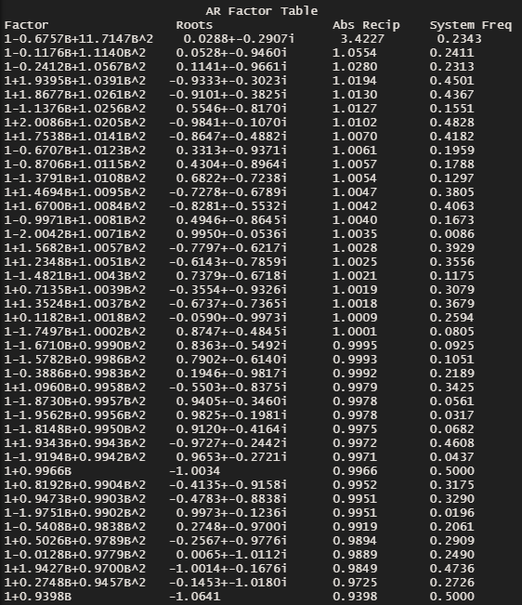
Seasonal Model – S = 7

Slide 4
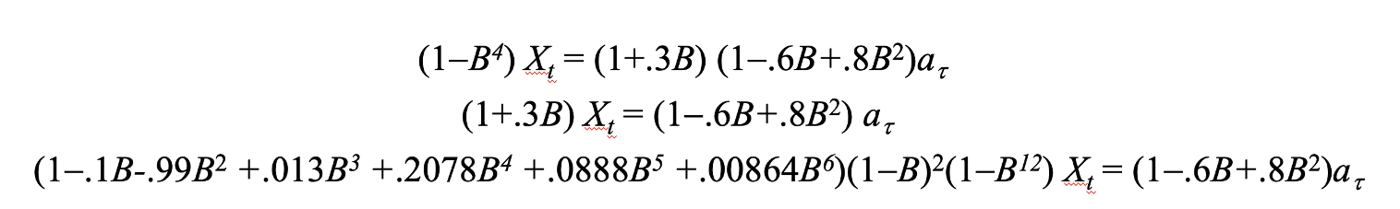
Comment and provide evidence (for each of the models) if they look to be:

Slide 5

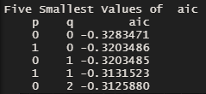
American Airlines Stock Data
Looking at the AIC results which give us an idea of the structure of the data now that we have taken the difference, we can see that the lowest AIC value would be p = 0, q = 0. So with this in mind, a seasonal ARUMA model would perhaps be a best fit for this data which is dealing with daily “close” values for the AAL stock.

Slide 6
Takeaways

Slide 7
Questions
How do we tell which AIC5 correlation structure is preferred with ARIMA models? With the ARMA models, it was the one with the lowest value, correct? That does not seem to be the case here, and I am a bit confused.
Also relating to the question above, is the best model different based on if we are using the first/ second difference?
Overall, I am a bit confused on how to tell when we should be using ARIMA vs ARUMA models.

